Slide 1
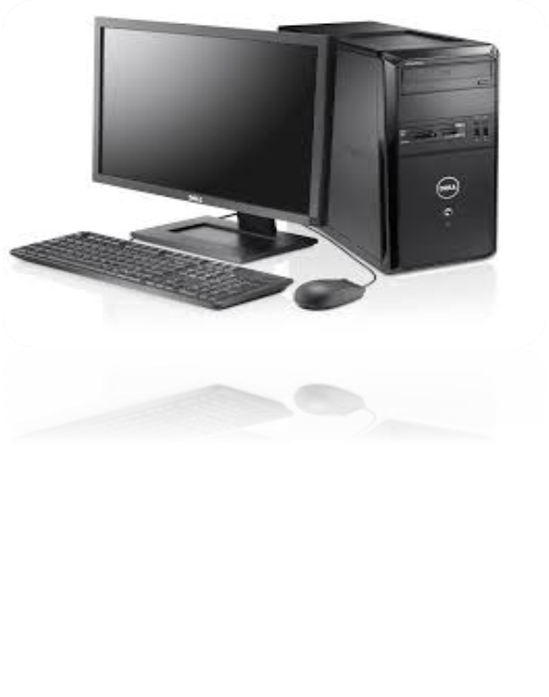
Unit 1: Introduction to Computer Hardware
IT 142 ICT Workshop
Prepared By:
Nehal Patel (I.T. Dept.)

Slide 2
Topics to be Discussed
Definition of Computer
Computer Hardware
Software
Firmware
History of Computer
Classification of Computer
Nehal Patel (I.T. Dept.)

Slide 3
What is A Computer?
An electronic machine/device that manipulates information, or data.
Ability to store, retrieve, and process data.
Input-Process-Output
  Capable of solving problem or manipulating data by accepting data
  Performing mathematical or logical operations on data.
  Supplying the result of these operations as output.
Input
Process
Output
Storage
Communication
Nehal Patel (I.T. Dept.)

Slide 4
Characteristics of Computer
  Speed
    Quick performance & quick data input and information retrieval.
  Storage Capacity
    Ability to store data.
  Accuracy
    Computer is programmed, so whatever input we give it gives result accurately.
  No IQ
    Computer does not work without instruction.
  Versatility
    Perform completely different type of work at the same time.
Nehal Patel (I.T. Dept.)

Slide 5
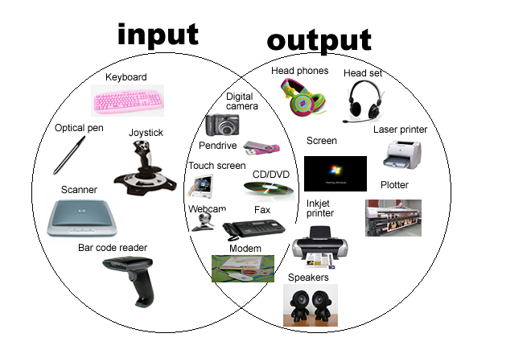
The Components of A Computer
Input Device:
It is a hardware use to enter data and instructions.
Converts the data into machine-readable form i.e binary form.
Output Device:
It is a hardware that conveys information to the user.
Converts the electronic data produced by the computer system.
Nehal Patel (I.T. Dept.)

Slide 6
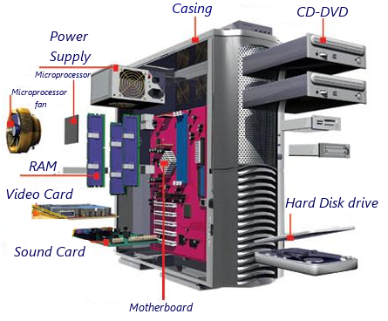
The Components of A Computer
System Unit:
Box-like case containing electronic components used to process data.
Pocessor, Memory, Adaptar Cards, Ports, Power Supply
Nehal Patel (I.T. Dept.)

Slide 7
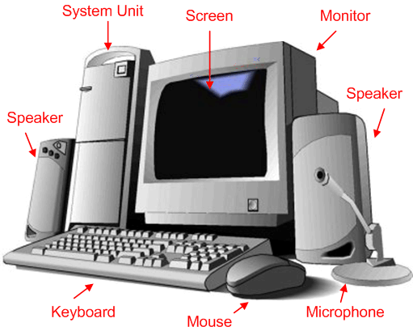
What is Hardware?
Hardware represents the physical and tangible components of a computer i.e. the components that can be seen and touched.
Examples:
Input devices -- keyboard, mouse etc.
Output devices -- printer, monitor etc.
Secondary storage devices -- Hard disk, CD, DVD etc.
Internal components -- CPU, motherboard, RAM etc.
Nehal Patel (I.T. Dept.)

Slide 8
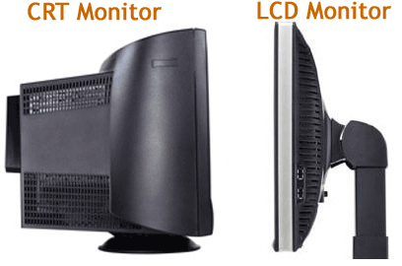
Monitor
A computer monitor is an electronic device that shows pictures. Monitors often look similar to televisions.
There are three types of computer displays:
CRT monitor (Cathode Ray Tube)
LCD monitor (Liquid Crystal Display)
Video Projectors
Nehal Patel (I.T. Dept.)

Slide 9
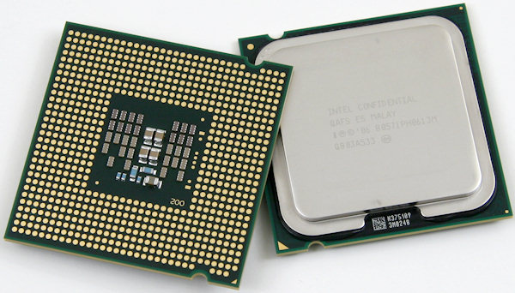
CPU
A Central Processing Unit (CPU) is a component in digital Computer that interprets computer program instructions and process data.
2 Major Manufactures are there:
  Intel : http://www.intel.com
  AMD : http://www.amd.com
Nehal Patel (I.T. Dept.)

Slide 10
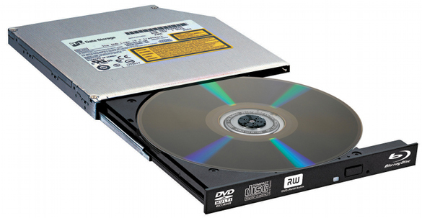
Optical Disk Drive
An optical drive is usually a CD drive or DVD drive.
The drive uses a light called a laser. A laser is the most exact and powerful sort of light but the laser in the drive is very, very small.
Types of Optical Drive
  CD Drive
  DVD Drive
  Blue-ray Drive
  HD-DVD Drive
Nehal Patel (I.T. Dept.)

Slide 11
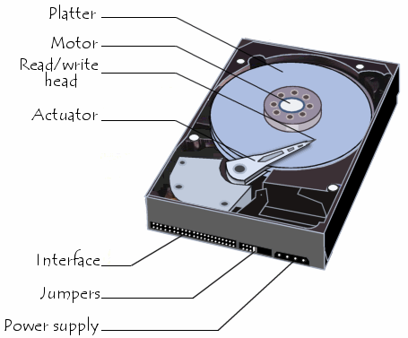
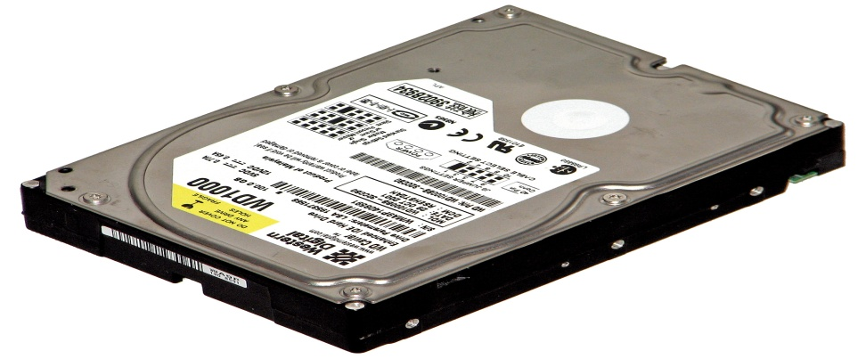
Hard Disk Drive
A hard disk drive (HDD), is something used by computers to store information.
Hard disks use magnetic recording (similar to the way recording is done on magnetic tapes) to store information on rotating circular platters.
The capacity of a hard drive is usually measured in gigabytes (GB).
Nehal Patel (I.T. Dept.)

Slide 12
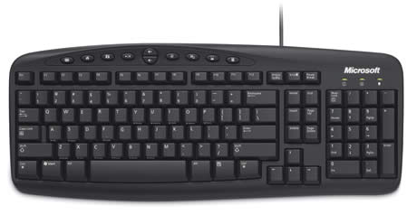
Keyboard
A computer keyboard is an important device that allows a person to enter symbols like letters and numbers into a computer.
It is the main input device for most computers.
Nehal Patel (I.T. Dept.)

Slide 13
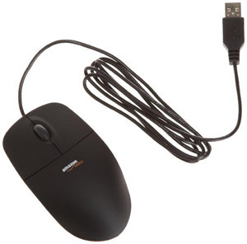
Mouse
A computer mouse is an input device that is most often used with a personal computer.
Moving a mouse along a flat surface can move the on-screen cursor to different items on the screen.
Items can be moved or selected by pressing the mouse buttons (called clicking).
Nehal Patel (I.T. Dept.)

Slide 14
What is Software?
Software is a set of programs, which is designed to perform a well-defined function. A program is a sequence of instructions written to solve a particular problem.
A software acts as an interface between the user and the hardware.
There are two types of software
System Software
Application Software
Some of those components, like Windows XP, Microsoft Word, Microsoft Excel, Windows Media Player, and all your other programs, are software.
Nehal Patel (I.T. Dept.)

Slide 15
What is Firmware?
It is pre-written program, which is stored in ROM. It is added at the time of manufacturing, which is used to run programs on the device.
Its combination of hardware and software.
ROMs, PROMs and EPROMs that have data or programs recorded on them are firmware.
Nehal Patel (I.T. Dept.)

Slide 16
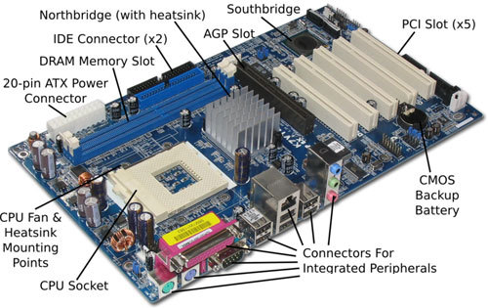
Motherboard
The motherboard is the main circuit board in a system, like a computer. It is the most 'central' part of a computer.
All of the different parts of the computer are connected to the motherboard.
Contains adaptar cards,processor chips and memory chips.
In most computers, the motherboard is a big green board, but many come in different colors like black, red and yellow.
Nehal Patel (I.T. Dept.)

Slide 17
Processor
What is central processing unit (CPU)?
It interprets and carries out basic instructions that operate a computer.
Control Unit:
Directs and Co-ordinates operations in computer.
Arithmetic Logical Unit:
ALU performs arithmetic, comparison and logical operations.
Processor
Control Unit
ALU
Nehal Patel (I.T. Dept.)

Slide 18
Memory
Memory is used to store data and instructions.
Cache Memory:
Cache memory is a very high speed semiconductor memory which can speed up CPU. It acts as a buffer between the CPU and main memory. It is used to hold those parts of data and program which are most frequently used by CPU.
Primary Memory: RAM,ROM
Stores all or part of the programs that is being executed
  RAM(Random Access Memory)
    It is the internal memory of the CPU for storing data, program and its result.
    Its contents will be lost when the computer is turned off.
Nehal Patel (I.T. Dept.)

Slide 19
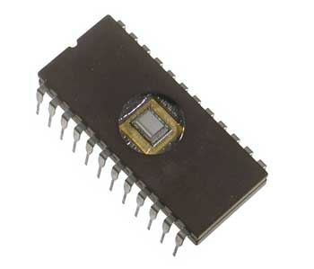
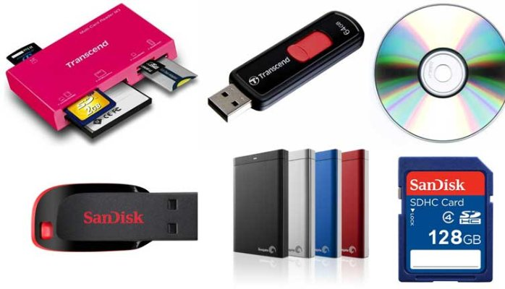
Cont..
ROM (Read Only Memory)
  The memory from which we can only read but cannot write on it. This type of memory is non-volatile.
  Stores important or frequently used programs.
Secondary Memory: Storage Devices
  Devices that store information.
  Stores important or frequently used programs.
  Example : Hard Disk Drive, CD and DVD drives, USB drives
Nehal Patel (I.T. Dept.)

Slide 20
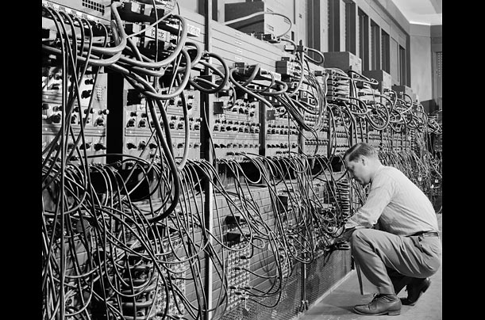
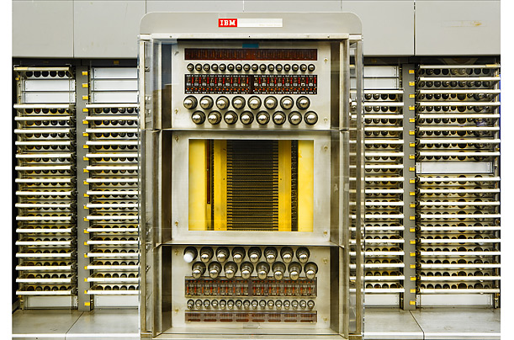
History Of Computer
SAGE,1954
A gigantic computerized air defense system, SAGE (Semi-Automatic Ground Environment) was designed to help the Air Force track radar data in real time. Equipped with technical advances such as modems and graphical displays, the machine weighed 300 tons and occupied one floor of a concrete blockhouse.
ENIAC,1946
Regarded as the first general purpose electronic computer, the Electronic Numerical Integrator and Computer (ENIAC) was initially commissioned for the use in World War II, but not completed until one year after the war had ended .
Nehal Patel (I.T. Dept.)

Slide 21
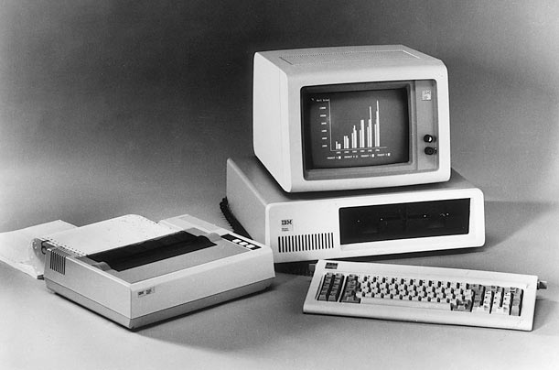
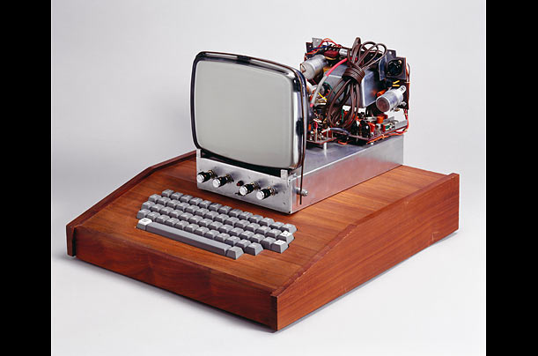
History Of Computer
AppleI,1976
Initially conceived by Steve Wozniak as a build-it-yourself kit computer, Apple I was initially rejected by his bosses at Hewlett-Packard. Undeterred, he offered it to Silicon Valley's Homebrew Computer Club and, together with his friend Steve Jobs, managed to sell 50 pre-built models to The Byte Shop in Mountain View, California.
IBM Personal Computer, 1981
Featuring an independent keyboard, printer and monitor, the slick, complete-looking package that was the IBM PC helped push personal computing out of the hobbyist's garage and into the corporate and consumer mainstream.
Nehal Patel (I.T. Dept.)

Slide 22
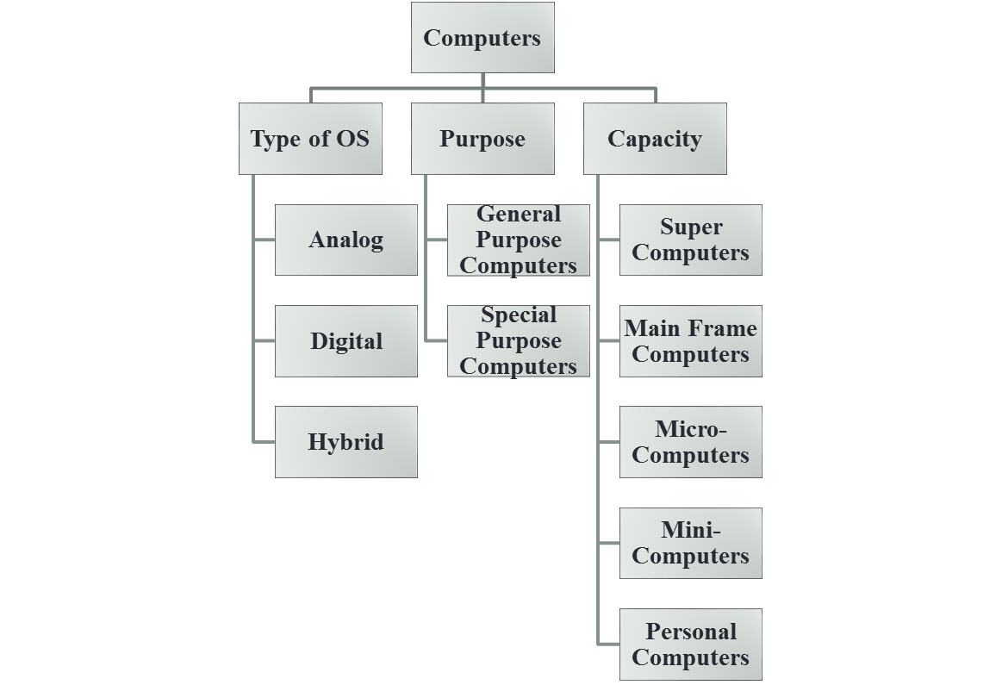
Classification Of Computer
Nehal Patel (I.T. Dept.)

Slide 23
Based on Operating System
Analog Computers
  Represent data in the form of continuous electrical signals.
  Used for scientific engineering application.
  These are sensitive to slightest changes.
  Eg: Thermometers,Barometers
Digital Computers
  Operate, store and process data in the digital form.
  Perform complex and repetitive calculations accurately.
  Eg : Calculators,all electronic computers etc.
Hybrid Computers
  Combination of analog and digital computer because it encompasses the best features of both.
Nehal Patel (I.T. Dept.)

Slide 24
Based on Purpose
General Purpose computers:
Capable of handling many kinds of operations.
Used for both business and scientific applications with equal efficiency.
Can be used at any place like offices, banks, schools etc.
Special Purpose computers:
Designed to perform specific task and cannot be used for other purposes.
Eg. Monitor patient’s health in hospitals, in airports to monitor arrival/departure of flights etc.,
Nehal Patel (I.T. Dept.)

Slide 25
Questions
Difference between Hardware & Software.
Explain in detail the Generations of computer.
What are the advantages and disadvantages of Computer?
Write in detail about the Basic components of computer.
Nehal Patel (I.T. Dept.)

Slide 26

THANK YOU ☺
Nehal Patel (I.T. Dept.)

